Slide 1
The Role of Uganda Communications Commission in the investigation and Prosecution of Cyber crimes in Uganda
DR. ABUDU SALLAM WAISWA
HEAD LEGAL AND COMPLIANCE
21st June 2024

Slide 3
OBJECTIVES OF COMMUNICATIONS REGULATION
01
Ease market entry and increase competition
Effective utilization of Resources
02
04
Protect Consumers & the Public against abuse & misuse of communication services
Ensure Quality of services
03

Slide 4
The Set-up of UCC
UCC is comprised of 7 departments, including the Legal department.
Besides licensing and offering general legal advisory services to the Commission, the Legal Department has a Compliance and Enforcement Unit, which ensures that all operators in the sector comply with all laws and standards with regard to operation of technologies under the purview of the Uganda Communications Act, 2013.
The Legal Department has 8 lawyers with prosecution certificates from the Directorate of Public Prosecution (DPP).
The Department also has a Police unit attached to the Commission to assist with investigations, arrest of suspects, and gathering of evidence.

Slide 5
Functions of the litigation & prosecution Unit
Represents the Commission in courts of law.
Prepares and files all Court documents (pleadings) on behalf of the Commission.
Peruses criminal files and advise Police in communication related criminal investigation.
Prepares witnesses in all UCC cases.
Advising the Commission on litigation related matters, including risks that may lead to litigation.
Provides legal advisory services to the Commission generally.

Slide 6
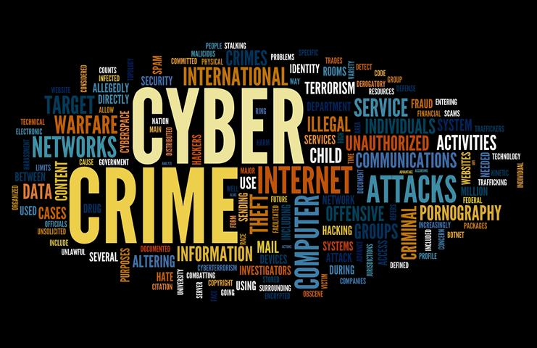
What is cyber crime?
There is no hard and first rule in defining Cyber Crime.
It can be defined as an illegal activity which is carried out by use of a computer to target a computer, networks, systems, data, websites, companies, institutions and/or individual persons, among others.

Slide 7
Role of UCC in investigations
Statistics from Uganda Police show that over 70% of the reported crimes are either conceived, procured, aided or actually committed through communication systems such as phones, computers and emails.
As the regulator of the communication sector therefore, UCC works closely with the Police & other security agencies in the investigation, detection and prosecution of offences that threaten our national security.
As the regulator of the Communications sector, UCC has regulatory powers over all telecom companies, radio, Tvs and Online data communication service providers.

Slide 8
Role of UCC in investigations
Support security agencies in obtaining evidence from licensees, such as Telecoms, Radios and Tvs. UCC does not have primary custody of call data and customer records. These are stored and kept by operators.
So, where the evidence in support of any crime relates to communication content, UCC can support the Police.
It should, however, be noted that according to s.11 of the Computer Misuse Act 2011, a production order can only be obtained against the person that has custody or control over the computer-based evidence that is needed for the investigation.
If the information related to Call records or TV/Radio content, the court order should be obtained against the respective operator.
UCC supports & connects security agencies to sector operators

Slide 9
The CERT
UCC set up the Computer Emergency Response Team (CERT).
This team has equipment and systems that can be used to track cyber related attacks or threats.
This is comprised of highly trained forensic and IT experts.
They operate an IT lab, that conducts forensic extractions from electronic devices, such as phones, laptops.
The team also handles complaints related to social media. They guide complainants in forwarding complaints to Facebook, Twitter and other social media companies.
Using the GSMA database, UCC supports security agencies in tracking stolen or other illegitimate communication devices.

Slide 10
Should court orders be sent to UCC first?
UCC has a seen a growing practice by judicial officer issuing Disclosure and production orders requiring UCC to produce or disclose Call Records and other customers information.
This is a mistake. UCC does not have custody of such information. The Order should be obtained against the respective Communication service provider. Sections 10&11 of computer Misuse Act 2011.
Where the operator does not comply with the court order, that is when you may write to UCC to compel the operator to release the required information.

Slide 11
Other key points to note
All requests for Customer information must be supported by a Court Order.
Telecoms Only keep Customer Call records for 6 months.
Telecoms do not record calls. Investigators should therefore not ask UCC to avail call recordings or videos.
Data Protection and Privacy law must always be adhered to.
Pay attention to the Fundamental rights enforcement Act 2019, which makes any persons individually liable for any human rights violation.

Slide 12
Challenges in investigation & prosecution of cyber crimes
Complexity of cross border investigations
Border lessness of cyber crime
Dynamism in the ICT sector, resulting into many innovations, which present unique regulatory challenges: Facebook Live, YouTube verses traditional broadcasting, & other live streams on social media.
Lack of sufficient human and technical capacity to investigate cyber crimes
Absence of Mutual Legal assistance law
Poor Coordination between cyber stakeholders, police telecom Companies, banks, FIA and forensic among others.
Shame and embarrassment which is often associated with being a victim of cyber crime
Low confidence in cyber investigations institutions
Anonymity and identity of cyber criminals who hide/mask their identities.
Cost implications associated with cyber crime investigations
Lack of public awareness of what constitutes cyber and where to report.

Slide 13
How we should protect ourselves against Cyber crimes
All users are potential victims of cyber crime.
Be alert when using digital platforms.
Don’t trust anonymous people that claim to be your former associates.
Regularly change your passwords.
Protect your SIM Cards. Do not allow people to transact using your SIM Card.
Check SIM Cards registered on your NIN. *197#
Do not easily trust business, love offers made by strangers
Report to telecom provider/banker immediately your phone is stolen.
Avoid keeping taking and storing intimate photos/videos on your digital tools.

Slide 14
How can the Judiciary ease cyber crime investigation & prosecution
Evidential weight of electronic evidence should not be unduly affected by strict rules. Section 29 of the Computer Misuse Act should be applied, to uphold best available electronic evidence, even if the same may not measure up to the ordinary primary evidential standards.
Convicts of Cyber crimes should be given deterrent penalties to scare other would offenders.
UCC does not have custody or control over everything in the cyber space. Production/disclosure orders for evidence like CDR, Mobile money statement, should not be issued against UCC, BUT the operators.
Where bail is granted, stringent measures should be imposed. It is difficult to trace for cyber crime suspects.
Judicial officials should continuously train and get exposed to cyber related laws and decisions.
Award monetary compensation orders to victims of cybercrimes-S.27 of Computer misuse Act.

Slide 15
QUOTE

Slide 16
THANK YOU

